Slide 1


IBM Course Seven
Data Analysis Using Python
Week Five

Slide 2
Objectives
Demonstrate the process of model evaluation in Python
Demonstrate the process of model refinement
Demonstrate the handling of fitting, underfitting, overfitting and model selection in Python
Demonstrate the process of ridge regression
Demonstrate the use of Grid search in Python

Slide 3
What is test data, train data and validation data?
Training Dataset: The sample of data used to fit the model.
Validation Dataset: The sample of data used to provide an unbiased evaluation of a model fit on the training dataset while tuning model hyperparameters. The evaluation becomes more biased as skill on the validation dataset is incorporated into the model configuration.
Test Dataset: The sample of data used to provide an unbiased evaluation of a final model fit on the training dataset.

Slide 4
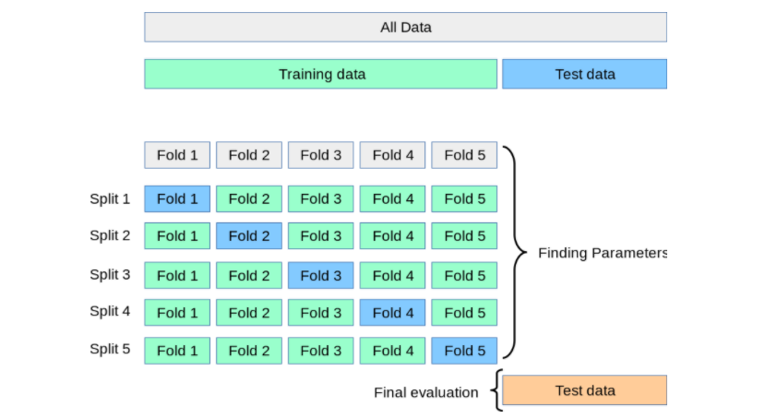
Split data

Slide 5
train_test_split()
X_train,x_test,y_train,y_test = train_test_split(x_data, y_data, test_size = 0.3, randome_state =0)

Slide 6
Cross Validation
Scores = cross_val_score(lr, x_data, y_data, cv =3)
np.mean(scores)
Yhat = cross_val_predict(lr2e, x_data, y_data, cv = 3)

Slide 7
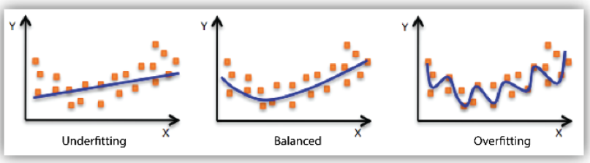
Overfitting and Underfitting

Slide 8
Underfitting
Causes
Trying to create a linear model with non linear data.
Having too little data to build an accurate model
Model is too simple, has too few features
Remedies
Add more features during Feature Selection.
Engineer additional features within the scope of your problem that makes sense.

Slide 9
Overfitting
Causes
The primary cause of models being overfit is that the algorithm captured the “noise” of the data.
Overfitting occurs when the model fits the data too well.
An overfit model shows low bias and high variance.
The model is excessively complicated likely due to redundant features.
Remedies
K-fold cross validation (refer here)
Train with more data
Remove features

Slide 10
Ridge Regression
Prevents Overfitting
From sklearn.linear-model import Ridge
RidgeModel = Ridge(alpha=0.1)
RidgeModel.fit(X,Y)
Yhat = RidgeModel.predict(Y)

Slide 11
Grid Search
Data broken into 3 sets
Training
Validation
Test

Slide 12
Parameters =[{‘alpha’ : [1, 10, 100, 1000]}]
From sklearn.linear-model import Ridge
From sklearn.model-selection import GridSearchCV
Parameters1 = [{‘alpha’:[0.001,0.1,1,10]}]
RR=Ridge()
Grid1 = GridSearchCV(RR, parameters1, cv = 4)
Grid1.fit(x_data[[‘Variable 1’ , ‘Variable 2’]], y_data)
Grid1. Best_estimator_
Scores = Grid1.CV_results_
Scores[‘mean_test_score’]

